Slide 1
COMP1003 – Algorithms, Data Structures & Maths Lecture 13 Module Content and Aims
(A&DS part)
Thomas Wennekers
Plymouth University

Slide 2
Main Ideas
DATA
Real world data is complex
Representing it on a computer
needs careful thought about structure
BIG DATA is a current research hype
CONTROL
Data needs to be stored, searched, processed …
“Algorithms” outline methods to do this

Slide 3
Why is this important ?
Computers are omnipresent …
.. and applied to (almost) everything
Luckily, there are a few (almost) universal data structures and associated algorithms, methods or operations, that repeat across many domains
Comp1003 is about these universal data types

Slide 4
Simple Data Types and Control
(Semester 1)
int
long
float
double
char
....
“atoms of data structure”
arithmetic
logic
statements
loops
if-then-else
blocks
…
“atoms of control flow”

Slide 5
things are more complex

Slide 6
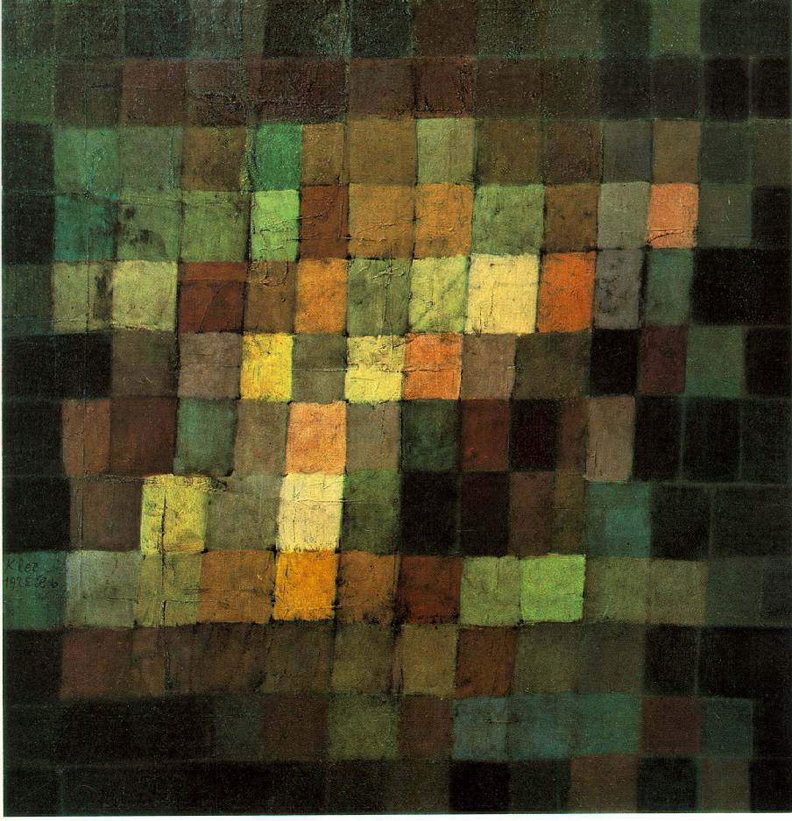
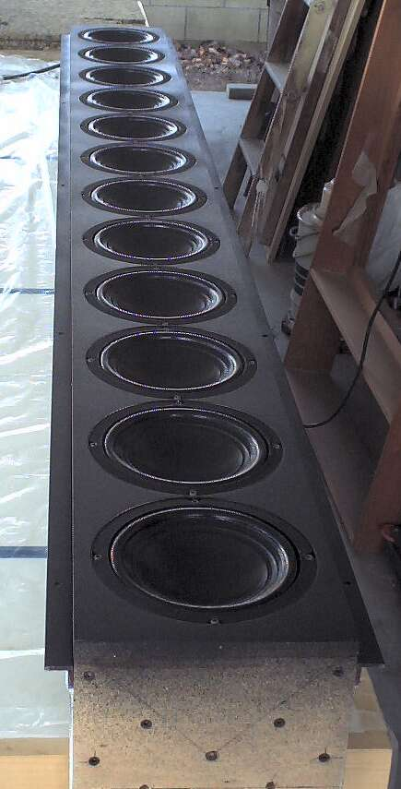
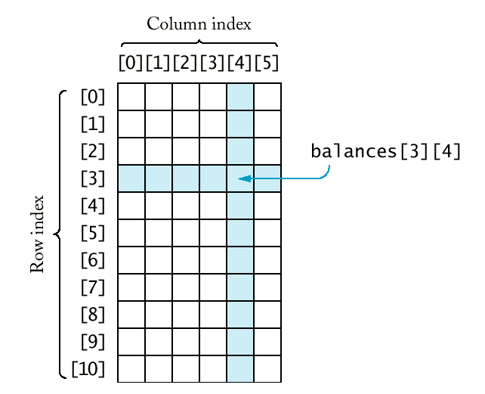


Arrays

Slide 7


Queues
First-in-first-out principle (FIFO)

Slide 8


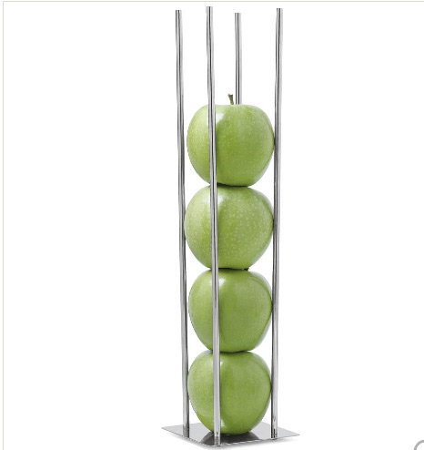

Stacks
Last-in-first-out Principle (LIFO)

Slide 9
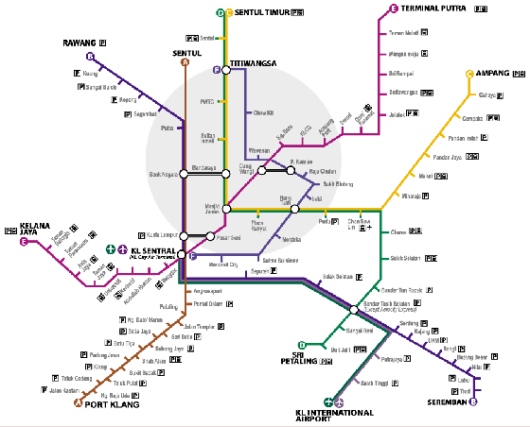
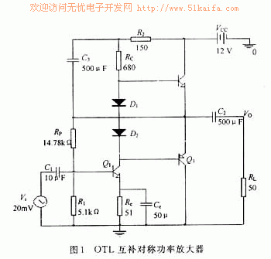

Graphs

Slide 10
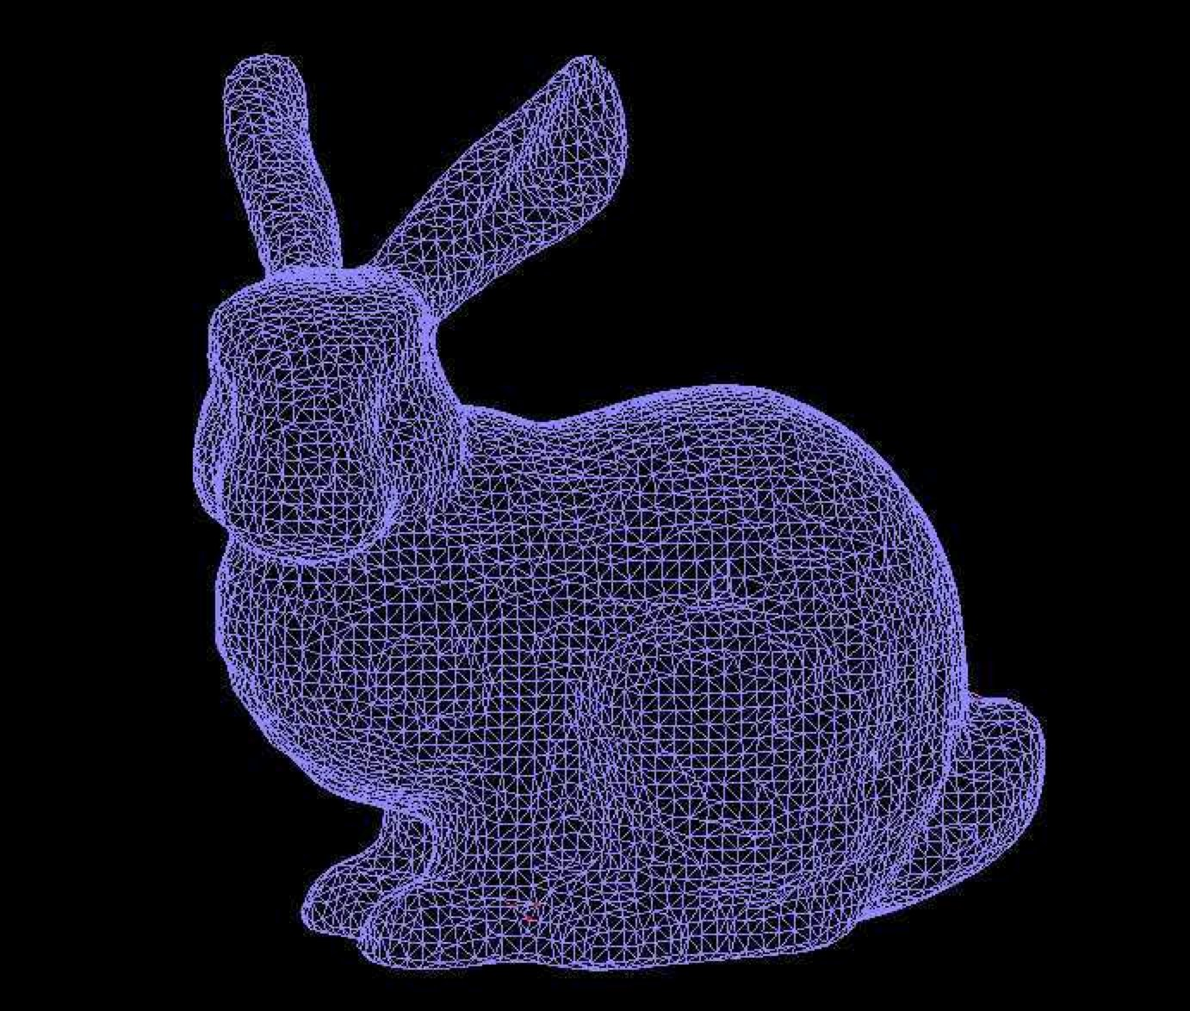

Slide 11
Data Structures
Array
Queue
Stack
List
Graphs
…
These and other data structures are central in computing; each structure has algorithms associated with it.

Slide 12
Aims of the Module
To introduce how these universal data types work
To introduce ways to characterise their efficiency
To encourage a way of “algorithmic thinking”

Slide 13
Where the module is not about
Modern computer languages have complex “built-in” data types
Professional programmers use these frequently
This module does not teach how to use specific implementations, but how to implement them

Slide 14
Relevance for your career
Questions at job interviews are often coming from either of two domains:
1) Algorithms and Data Structures
and
2) Object-oriented Programming --> Year 2
Beside these general topics further questions will address the jobs' specific requirements: data bases, networking, web scripting, etc.

Slide 15
Sorts of Problems
- "Find the largest and second largest elements in an array"
- "Count the number of duplicates in an unordered array of integers"
- "What is a HashMap?"
- "How does a Linked List work?"
- ..... plenty more ...
Algorithm&Data Structures provides the answers

